Slide 1
Network Layer and Subnetting

Slide 2
Session Objectives
After going through this session you will learn
Network Layer Services
IPv4 Addressing
Subnetting
IP Packet Forwarding
Notes:
1.#

Slide 3
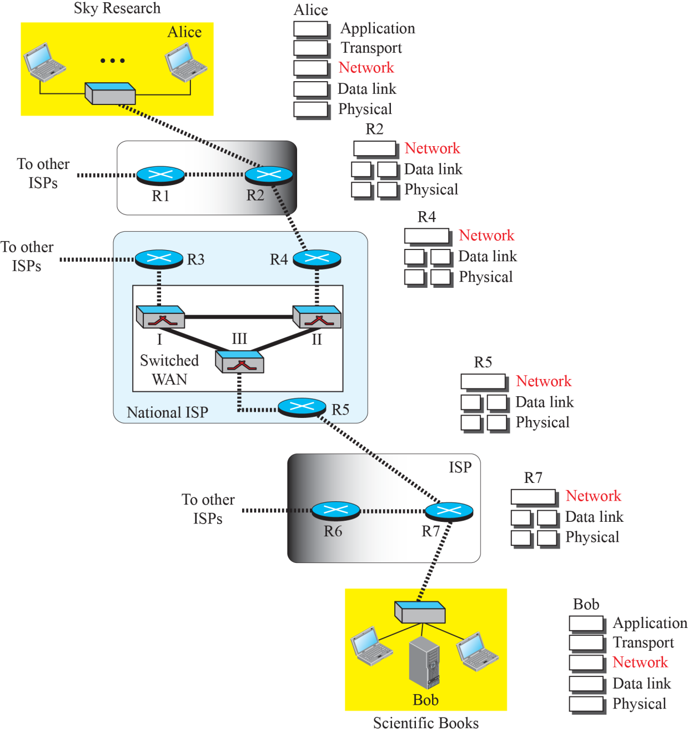
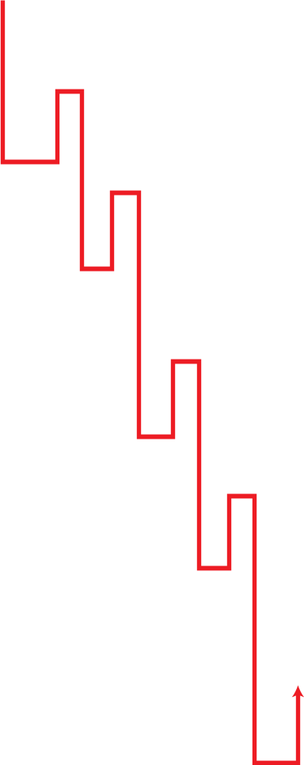
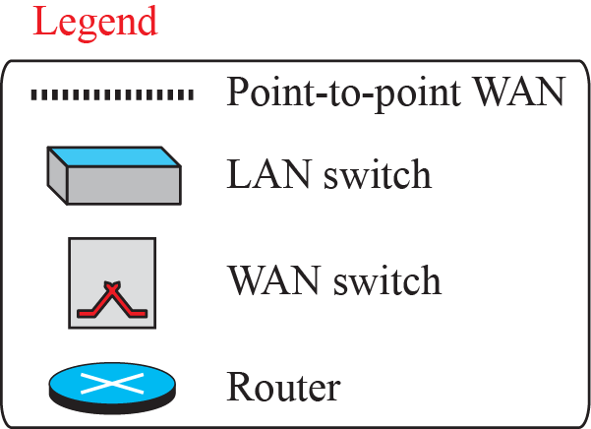
Network Layer Routing
Notes:
1.#

Slide 4
    Packetizing and Depacketizing Service
The network layer does packetizing; means encapsulating the payload in a network-layer packet at the source.
Secondly, it does de-capsulating the payload from the network-layer packet at the destination.
In other words, one duty of the network layer is to carry a payload from the source to the destination without changing it or using it.
The network layer is doing the service of a carrier such as the postal office, which is responsible for delivery of packages from a sender to a receiver without changing or using the contents.
Notes:
12.#

Slide 5
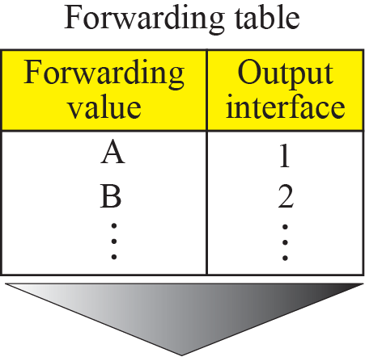
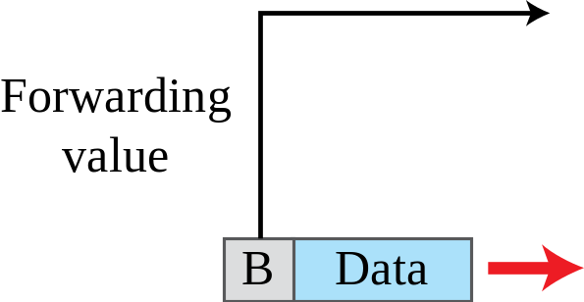
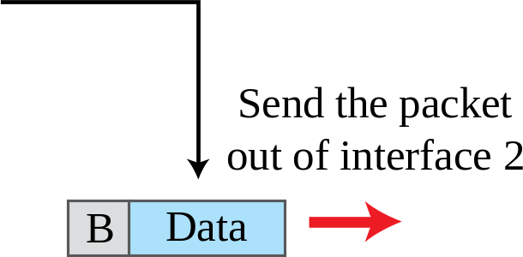
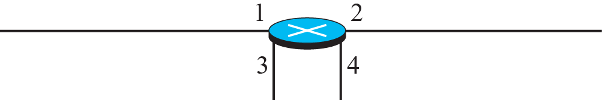
    Routing and Forwarding Service
Other duties of the network layer, which are as important as the first, are routing and forwarding, which are directly related to each other.
Notes:
12.#

Slide 6


    IPv4 Addressing
The identifier used in the IP layer of the TCP/IP protocol suite to identify the connection of each device to the Internet is called the Internet address or IP address.
An IPv4 address is a 32-bit address that uniquely and universally defines the connection of a host or a router to the Internet.
An address space is the total number of addresses used by the protocol.
IPv4 uses 32-bit addresses, which means that the address space is 4,294,967,296 (more than four billion).
Notes:
12.#

Slide 7
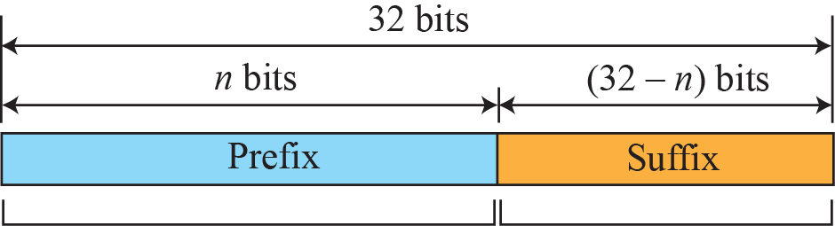
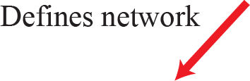


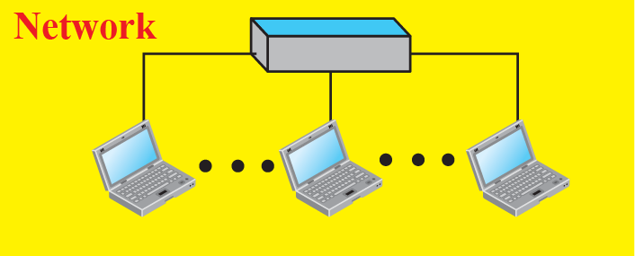
    Classful IPv4 Addressing
Notes:
12.#

Slide 8
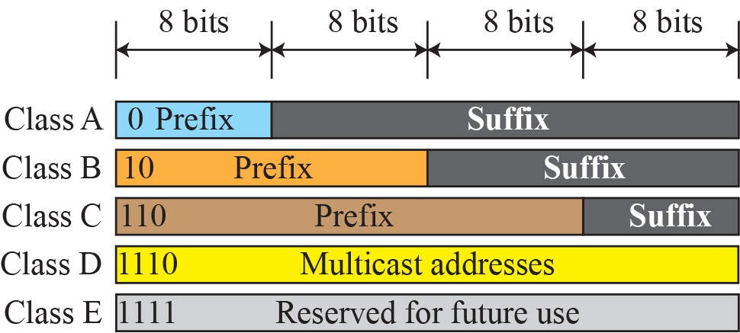
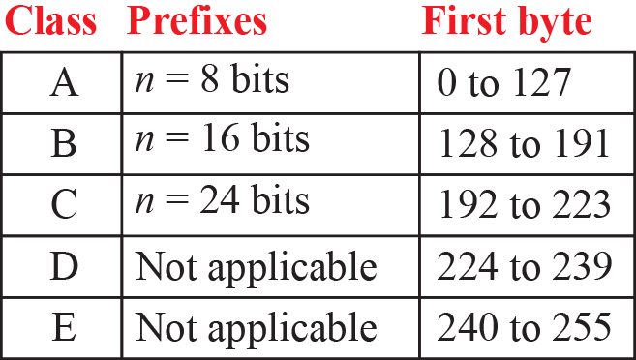
    Classful IPv4 Addressing
When the Internet started, an IPv4 address was designed with a fixed-length prefix, but to accommodate both small and large networks, three fixed-length prefixes were designed instead of one (n = 8, n = 16, and n = 24).
The whole address space was divided into five classes (class A, B, C, D, and E), as shown in Figure below. This scheme is referred to as classful addressing.
Notes:
12.#

Slide 9
Class | Leading bits | Size of network number bit field | Size of rest bit field | Number of networks | Addresses per network | Total addresses in class | Start address | End address | Default subnet mask in dot-decimal notation | CIDR notation
Class A | 0 | 8 | 24 | 128 (2⁷) | 16,777,216 (2²⁴) | 2,147,483,648 (2³¹) | 0.0.0.0 | 127.255.255.255 | 255.0.0.0 | /8
Class B | 10 | 16 | 16 | 16,384 (2¹⁴) | 65,536 (2¹⁶) | 1,073,741,824 (2³⁰) | 128.0.0.0 | 191.255.255.255 | 255.255.0.0 | /16
Class C | 110 | 24 | 8 | 2,097,152 (2²¹) | 256 (2⁸) | 536,870,912 (2²⁹) | 192.0.0.0 | 223.255.255.255 | 255.255.255.0 | /24
Class D (multicast) | 1110 | not defined | not defined | not defined | not defined | 268,435,456 (2²⁸) | 224.0.0.0 | 239.255.255.255 | not defined | not defined
Class E (reserved) | 1111 | not defined | not defined | not defined | not defined | 268,435,456 (2²⁸) | 240.0.0.0 | 255.255.255.255 | not defined
Notes:
12.#

Slide 10
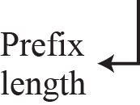
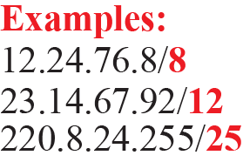
    Classless IPv4 Addressing
With the growth of the Internet, it was clear that a larger address space was needed as a long-term solution.
The larger address space, however, requires that the length of IP addresses also be increased, which means the format of the IP packets needs to be changed.
Although the long-range solution has already been devised and is called IPv6, a short-term solution was also devised to use the same address space but to change the distribution of addresses to provide a fair share to each organization.
The short-term solution still uses IPv4 addresses, but it is called classless addressing.
Notes:
12.#

Slide 11
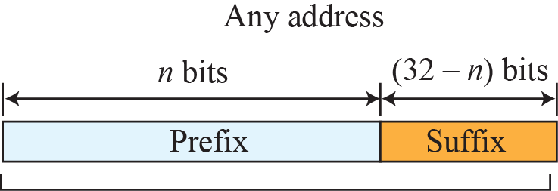
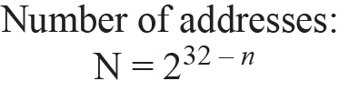
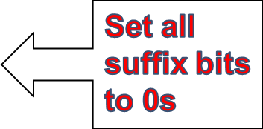
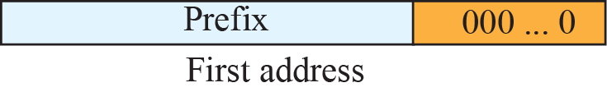
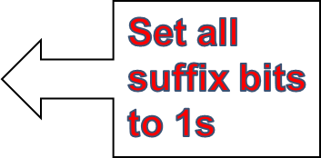
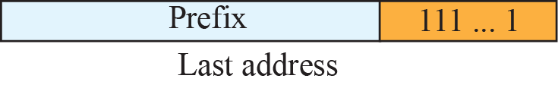
    Information Extraction in Classless Addressing
Notes:
12.#

Slide 12
    Example 1
A classless address is given as 167.199.170.82/27. Find the total host address space, first address and last address.
The number of addresses (N) in the network is 2^{32− n} = 2⁵ = 32 addresses.
The first address can be found by keeping the first 27 bits and changing the rest of the bits to 0s.
The last address can be found by keeping the first 27 bits and changing the rest of the bits to 1s.
Notes:
12.#

Slide 13
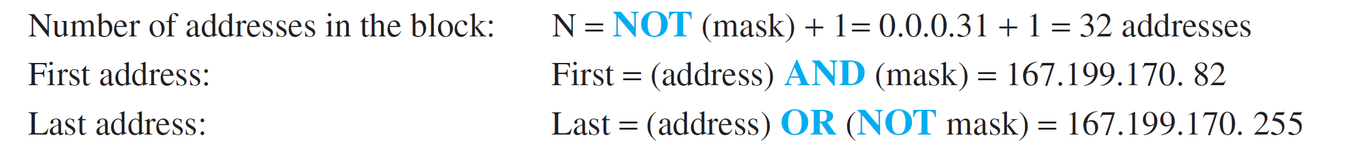
    Example 2: Applying Mask to find the same information
We repeat Example 1 using the mask.
The mask in dotted-decimal notation is 256.256.256.224
The AND, OR, and NOT operations can be applied to individual bytes.
64
95
Notes:
12.#

Slide 14
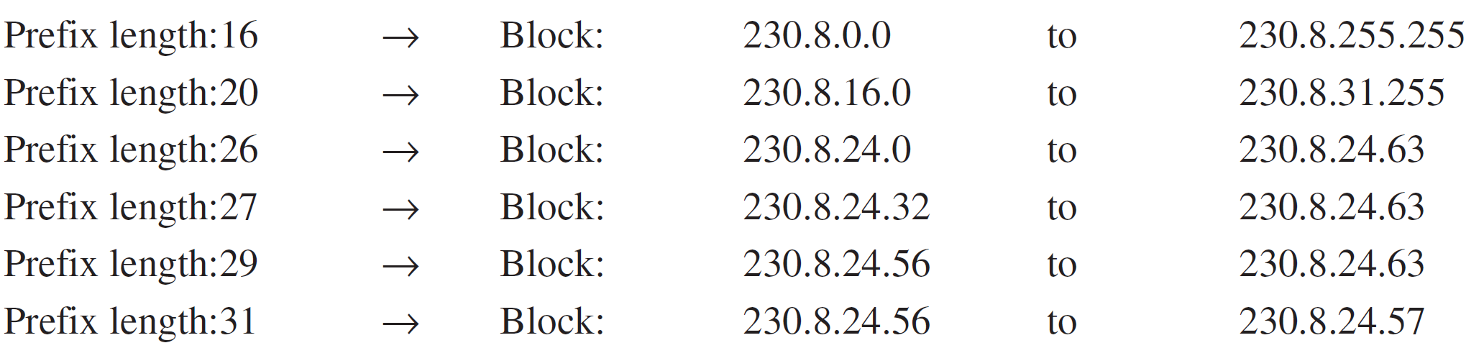
    Example 3: Classless Addressing Block
In classless addressing, an address cannot define the block the address belongs to.
For example, the address 230.8.24.56 can belong to many blocks. Some of them are shown below with the value of the prefix associated with that block.
Notes:
12.#

Slide 15
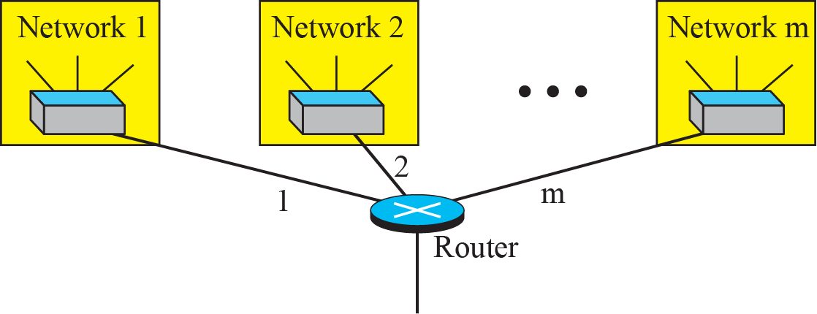
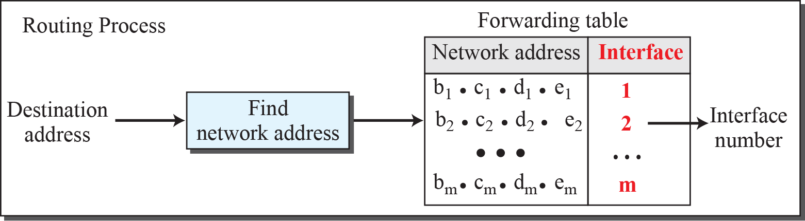
    Network Address based Routing Process
Notes:
12.#

Slide 16
    Example 4: Sub netting a Network
An organization is granted a block of addresses with the beginning address 14.24.74.0/24. The organization needs to have 3 subblocks of addresses to use in its three subnets: one subblock of 10 addresses, one subblock of 60 addresses, and one subblock of 120 addresses. Design the subblocks.
Solution
There are 2^{32– 24} = 256 addresses in this block. The first address is 14.24.74.0/24; the last address is 14.24.74.255/24. To satisfy the third requirement, we assign addresses to subblocks, starting with the largest and ending with the smallest one.
a. The number of addresses in the largest subblock, which requires 120 addresses, is not a power of 2. We allocate 128 addresses. The subnet mask for this subnet can be found as n₁ = 32 − log₂ 128 = 25. The first address in this block is 14.24.74.0/25; the last address is 14.24.74.127/25.
b. The number of addresses in the second largest subblock, which requires 60 addresses, is not a power of 2 either. We allocate 64 addresses. The subnet mask for this subnet can be found as n₂ = 32 − log₂ 64 = 26. The first address in this block is 14.24.74.128/26; the last address is 14.24.74.191/26.

Slide 17
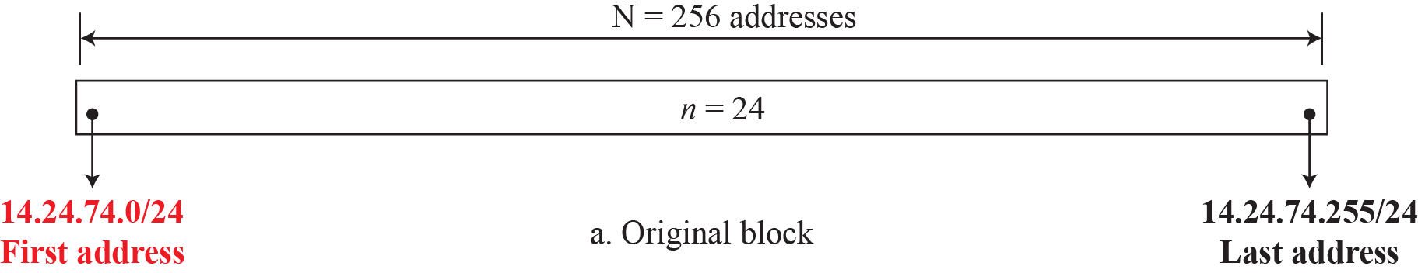
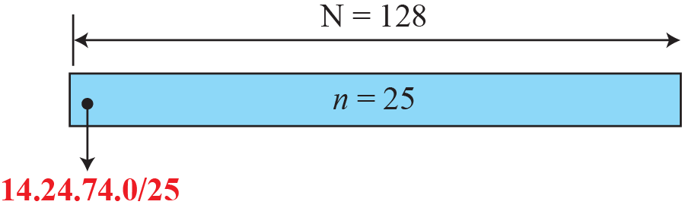
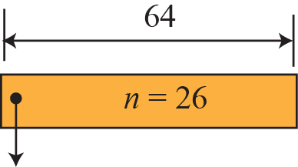
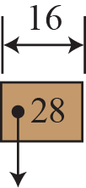
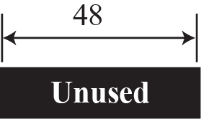


c. The number of addresses in the smallest subblock, which requires 10 addresses, is not a power of 2. We allocate 16 addresses. The subnet mask for this subnet can be found as n₁ = 32 − log₂ 16 = 28. The first address in this block is 14.24.74.192/28; the last address is 14.24.74.207/28.
If we add all addresses in the previous subblocks, the result is 208 addresses, which means 48 addresses are left in reserve. The first address in this range is 14.24.74.208. The last address is 14.24.74.255. We don’t know about the prefix length yet. Figure below shows the configuration of blocks. We have shown the first address in each block.
14.24.74.192/28
Notes:
12.#

Slide 18
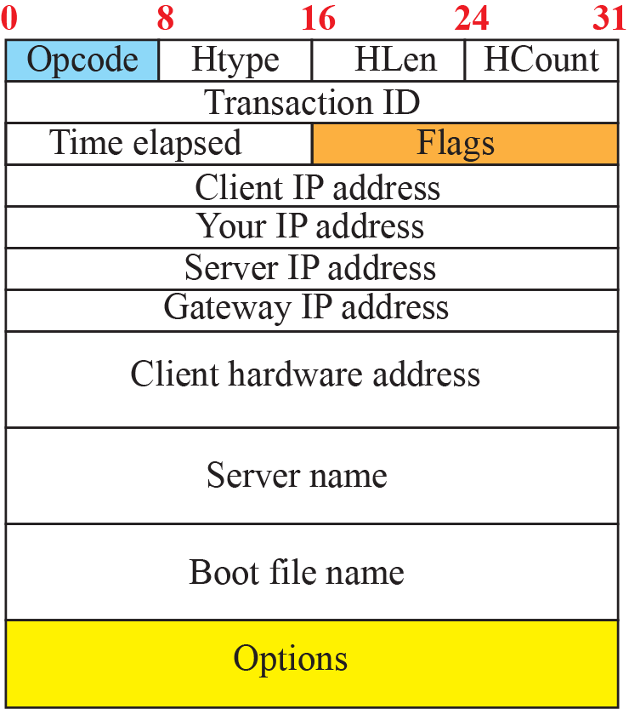
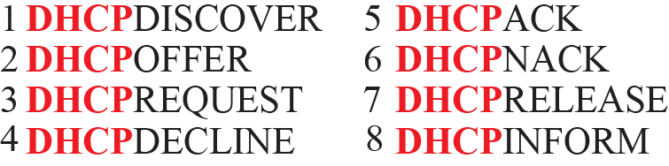
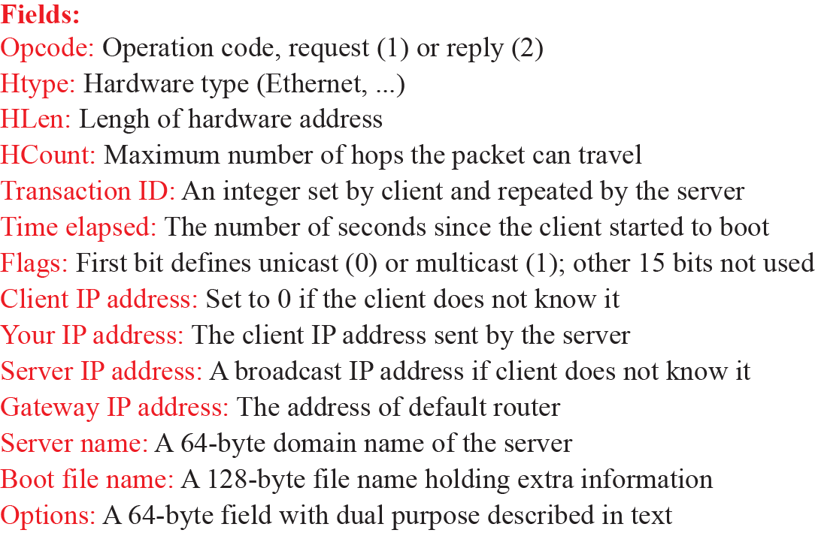

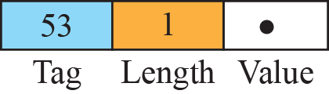
    Dynamic Host Configuration Protocols (DHCP)
After a block of addresses are assigned to an organization, the network administration can manually assign addresses to the individual hosts or routers.
However, address assignment in an organization can be done automatically using the Dynamic Host Configuration Protocol (DHCP).
DHCP is an application-layer program, using the client-server paradigm, that actually helps TCP/IP at the network layer.
Notes:
12.#

Slide 19


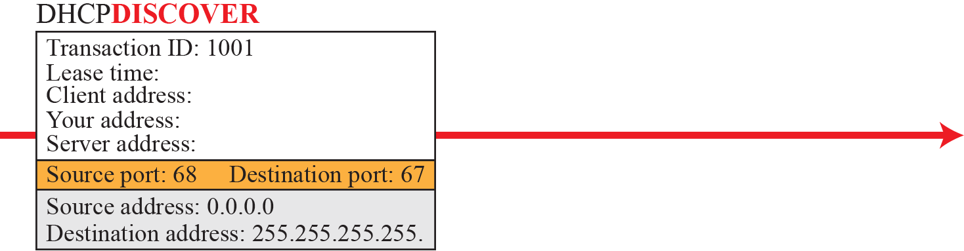
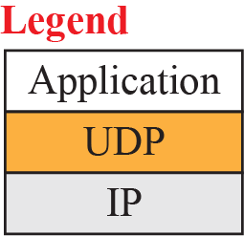
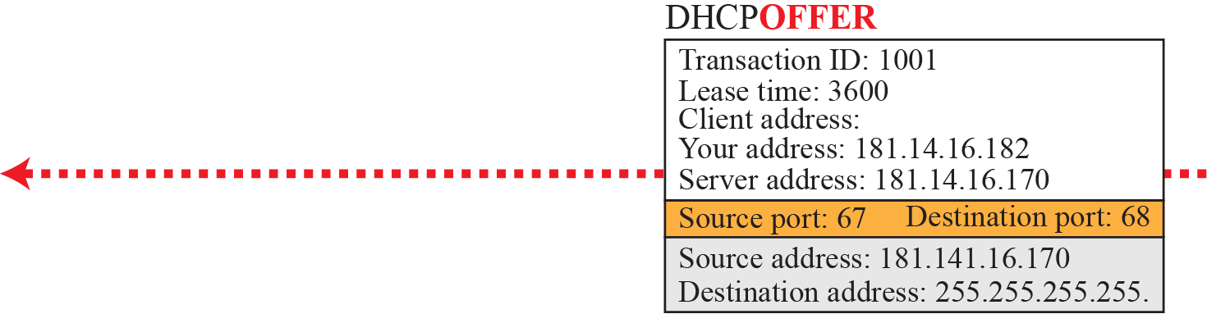
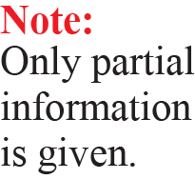
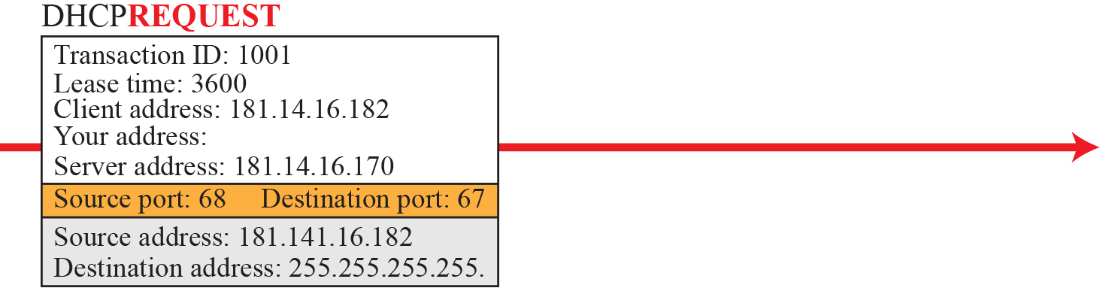
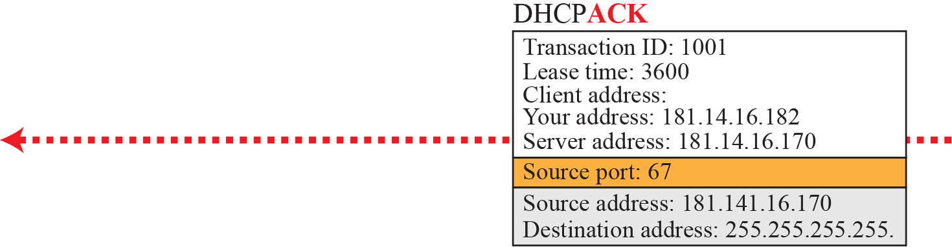
    DHCP Operation
Notes:
12.#

Slide 20
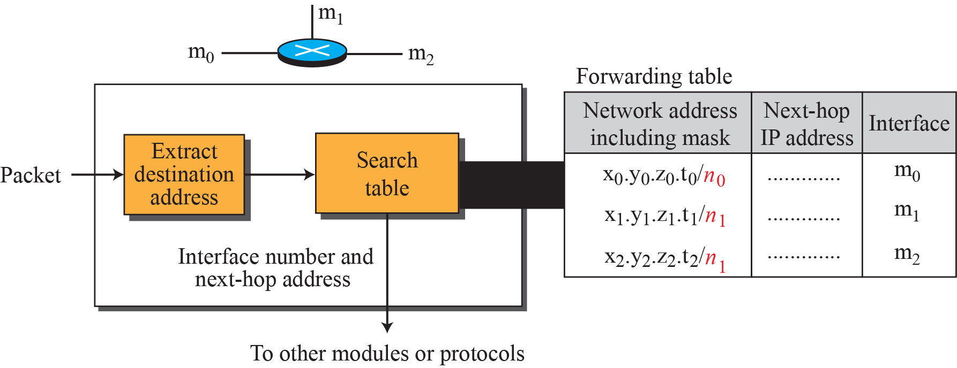
    Forwarding based on Destination Address
Here we will discuss forwarding based on the destination address. This is a traditional approach, which is prevalent today.
In this case, forwarding requires a host or a router to have a forwarding table.
When a host has a packet to send or when a router has received a packet to be forwarded, it looks at this table to find the next hop to deliver the packet to.
Notes:
12.#

Slide 21
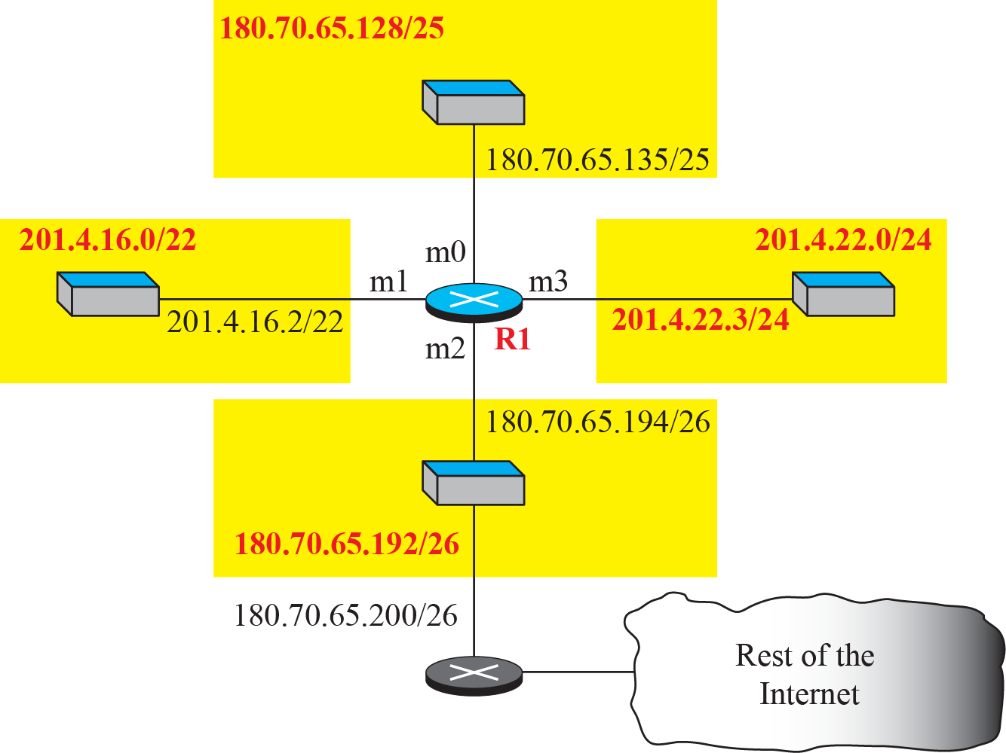
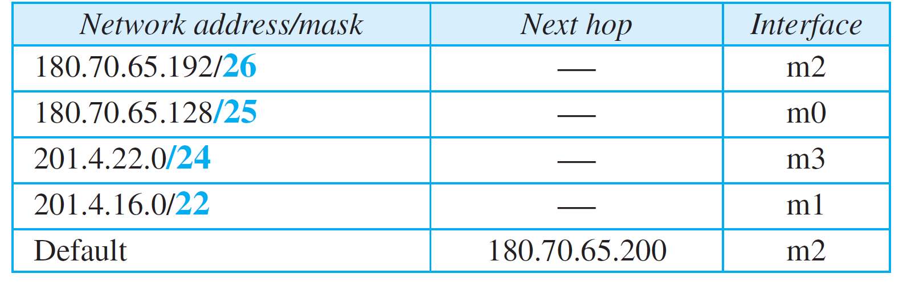
    Example 6.1: Creating Forwarding Table
Make a forwarding table for router R1 using the configuration in adjacent Figure.
Solution
Forwarding table for router R1.
Notes:
12.#

Slide 22
    Example 6.2: Forwarding Process using Table
Show the forwarding process if a packet arrives at R1 in previous Figure with the destination address 180.70.65.140.
Solution
The router performs the following steps:
The first mask (/26) is applied to the destination address. The result is 180.70.65.128, which does not match the corresponding network address.
The second mask (/25) is applied to the destination address. The result is 180.70.65.128, which matches the corresponding network address. The next-hop address and the interface number m0 are extracted for forwarding the packet.
Notes:
12.#

Slide 23
    Available Class A Networks
Mask | Prefix | Subnets | Hosts
255.0.0.0 | (/8) | 1 network | with 16,777,214 hosts
255.128.0.0 | (/9) | 2 subnets | with 8,388,606 hosts each
255.192.0.0 | (/10) | 4 subnets | with 4,194,302 hosts each
255.224.0.0 | (/11) | 8 subnets | with 2,097,150 hosts each
255.240.0.0 | (/12) | 16 subnets | with 1,048,574 hosts each
255.248.0.0 | (/13) | 32 subnets | with 524,286 hosts each
255.252.0.0 | (/14) | 64 subnets | with 262,142 hosts each
255.254.0.0 | (/15) | 128 subnets | with 131,070 hosts each
255.255.0.0 | (/16) | 256 subnets | with 65,534 hosts each
255.255.128.0 | (/17) | 512 subnets | with 32,766 hosts each
255.255.192.0 | (/18) | 1,024 subnets | with 16,384 hosts each
255.255.224.0 | (/19) | 2,048 subnets | with 8,190 hosts each
255.255.240.0 | (/20) | 4,096 subnets | with 4,094 hosts each
255.255.248.0 | (/21) | 8,192 subnets | with 2,046 hosts each
255.255.252.0 | (/22) | 16,384 subnets | with 1,022 hosts each
255.255.254.0 | (/23) | 32,768 subnets | with 510 hosts each
255.255.255.0 | (/24) | 65,536 subnets | with 254 hosts each
255.255.255.128 | (/25) | 131,072 subnets | with 126 hosts each
255.255.255.192 | (/26) | 262,144 subnets | with 62 hosts each
255.255.255.224 | (/27) | 524,288 subnets | with 30 hosts each
255.255.255.240 | (/28) | 1,048,576 subnets | with 14 hosts each
255.255.255.248 | (/29) | 2,097,152 subnets | with 6 hosts each
255.255.255.252 | (/30) | 4,194,304 subnets | with 2 hosts each
Notes:
12.#

Slide 24
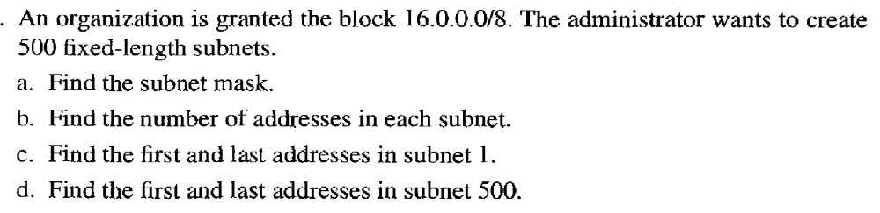
    Subnetting Practice Questions
Notes:
12.#

Slide 25
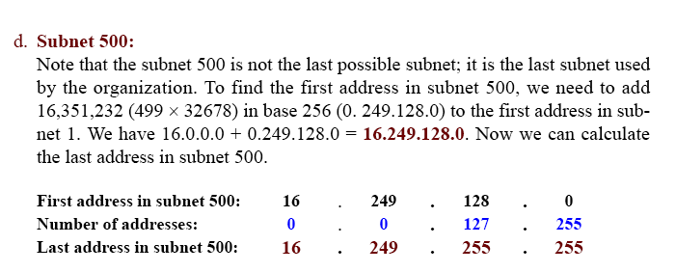
    Solution
Notes:
12.#

Slide 26
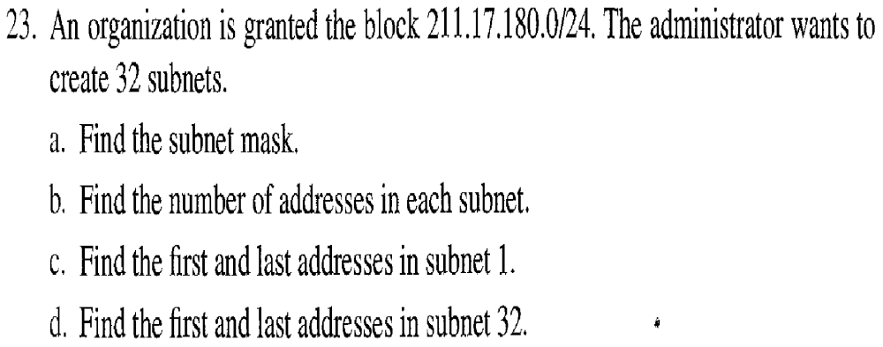
    Subnetting Practice Questions
Notes:
12.#

Slide 27
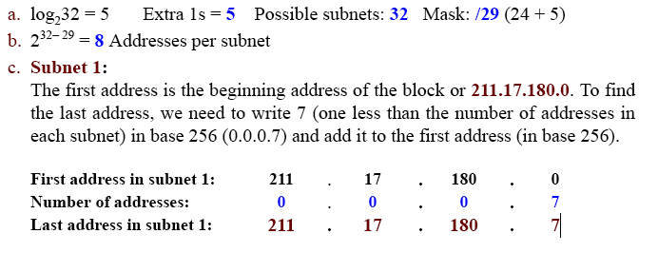
    Solution
In 32 block
First add: 211.17.180.240
Last add: 211.17.180.247
Notes:
12.#

Slide 28
Summary
In this section we have discussed the following:
Network Layer
IPv4 addressing
Classful Addressing with A, B, C Classes.
Classless Subnetting.
IP based routing in network
Notes:
1.#

Slide 29

Notes:
1.#

